Slide 1
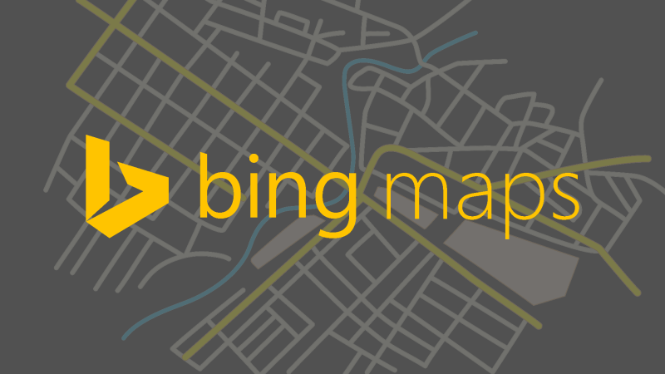





Accelerate development with Cosmos DB using Table API
Lab 1
Modernizing cloud-based web apps
Global Distribution
Bing Map API
REGION 1
REGION 2
REGION 3
Azure Cosmos DB
(Table API)
REGION 4
Query
ContosoAir App
REGION 6
REGION 5
App Service
Throughput
Latency
Notes:
AdventureWorks seeks to achieve global scale by serving bike stores around the world. It must ensure that bikes are available all over the world, and that changes to products are replicated to every region as fast as possible. This will allow customers to receive updated products regardless of their location.
It is currently not possible to replicate products in stores across multiple regions. It must be done manually, introducing variable outcomes and dramatically slowing product updates.
It is also challenging to configure data by region to ensure certain regional preferences. This makes it difficult to ensure that stores in the same region can take advantage of similar business conditions.

Slide 2
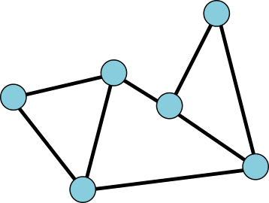
Accelerate development with Cosmos DB Graph (Gremlin) API
Lab 1
Modernizing cloud-based web apps
Global Distribution
Display Graph on App
REGION 1
REGION 2
REGION 3
Azure Cosmos DB
Graph (Gremlin) API
REGION 4
Query
ContosoAir App
REGION 6
REGION 5
App Service
Throughput
Latency
Notes:
AdventureWorks seeks to achieve global scale by serving bike stores around the world. It must ensure that bikes are available all over the world, and that changes to products are replicated to every region as fast as possible. This will allow customers to receive updated products regardless of their location.
It is currently not possible to replicate products in stores across multiple regions. It must be done manually, introducing variable outcomes and dramatically slowing product updates.
It is also challenging to configure data by region to ensure certain regional preferences. This makes it difficult to ensure that stores in the same region can take advantage of similar business conditions.

Slide 3












Accelerate development with Cosmos DB Graph (Gremlin) API
Lab 1
Modernizing cloud-based web apps
Store Bulk Data into Comos DB
Display Graph for Codeshare on App
REGION 1
REGION 2
Data
Azure Cosmos DB
Graph (Gremlin) API
REGION 3
REGION 4
ContosoAir App
App Service
REGION 6
REGION 5
Notes:
AdventureWorks seeks to achieve global scale by serving bike stores around the world. It must ensure that bikes are available all over the world, and that changes to products are replicated to every region as fast as possible. This will allow customers to receive updated products regardless of their location.
It is currently not possible to replicate products in stores across multiple regions. It must be done manually, introducing variable outcomes and dramatically slowing product updates.
It is also challenging to configure data by region to ensure certain regional preferences. This makes it difficult to ensure that stores in the same region can take advantage of similar business conditions.

Slide 4

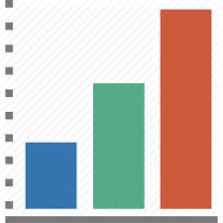



Predictive analysis using DocumentDB, Machine Learning and Power BI
SCENARIO 5
Modernizing cloud-based web apps
CosmosDB (DocumentDB)
Predictive Analysis
ContosoAir APP
Machine Learning
Azure Functions
Data
Notes:
Traditional data warehouses have fixed storage volume and cannot adjust their capacity based on need. This leads to over resourced or under resourced data warehouses, particularly in scenarios where demand is difficult to forecast.
These data warehouses also struggle to manage a variety of data types, including complex non-relational data which may not be conducive to conventional table storage.

